Slide 1
Legacy of Roman Mythology Bachelor’s Thesis
Here is where your presentation begins

Slide 2

Contents of this template
This is a slide structure based on a Thesis Defense presentation
You can delete this slide when you’re done editing the presentation
Fonts | To view this template correctly in PowerPoint, download and install the fonts we used
USED and ALTERNATIVE RESOURCES | An assortment of graphic resources that are suitable for use in this presentation here
Thanks slide | You must keep it so that proper credits for our design are given
Colors | All the colors used in this presentation
Infographic resources | These can be used in the template, and their size and color can be edited
Customizable icons | They are sorted by theme so you can use them in all kinds of different templates and presentations
For more info:
SLIDESGO | SLIDESGO SCHOOL | FAQS
You can visit our sister projects:
FREEPIK | FLATICON | STORYSET | WEPIK | VIDFY

Slide 3

Table of contents
01
02
03
04
05
06
Purpose
Hypothesis
Objectives
You can describe the topic of the section here
You can describe the topic of the section here
You can describe the topic of the section here
Methodology
Analysis
Conclusion
You can describe the topic of the section here
You can describe the topic of the section here
You can describe the topic of the section here

Slide 4
Purpose statement
What is roman mythology?
Mercury is the closest planet to the Sun and the smallest one in the Solar System—it’s only a bit larger than the Moon
What are its CharacteRistics?
Venus has a beautiful name and is the second planet from the Sun. It’s terribly hot—even hotter than Mercury
Who were the roman gods?
Jupiter is a gas giant and the biggest planet in the Solar System. It's the fourth-brightest object in the night sky

Slide 5
—Someone famous
“This is a quote, words full of wisdom that someone important said and can make the reader get inspired”

Slide 6


Introduction
Venus has a beautiful name and is the second planet from the Sun. It’s terribly hot, even hotter than Mercury, and its atmosphere is extremely poisonous

Slide 7
Current situation & problems statement
Current situation
Earth
Mars
Mercury
Earth is the third planet from the Sun and has life
Despite being red, Mars is actually a cold place
Mercury is the smallest planet in the Solar System
Jupiter is a gas giant and the biggest planet in the Solar System. It's the fourth-brightest object in the night sky
Problems

Slide 8

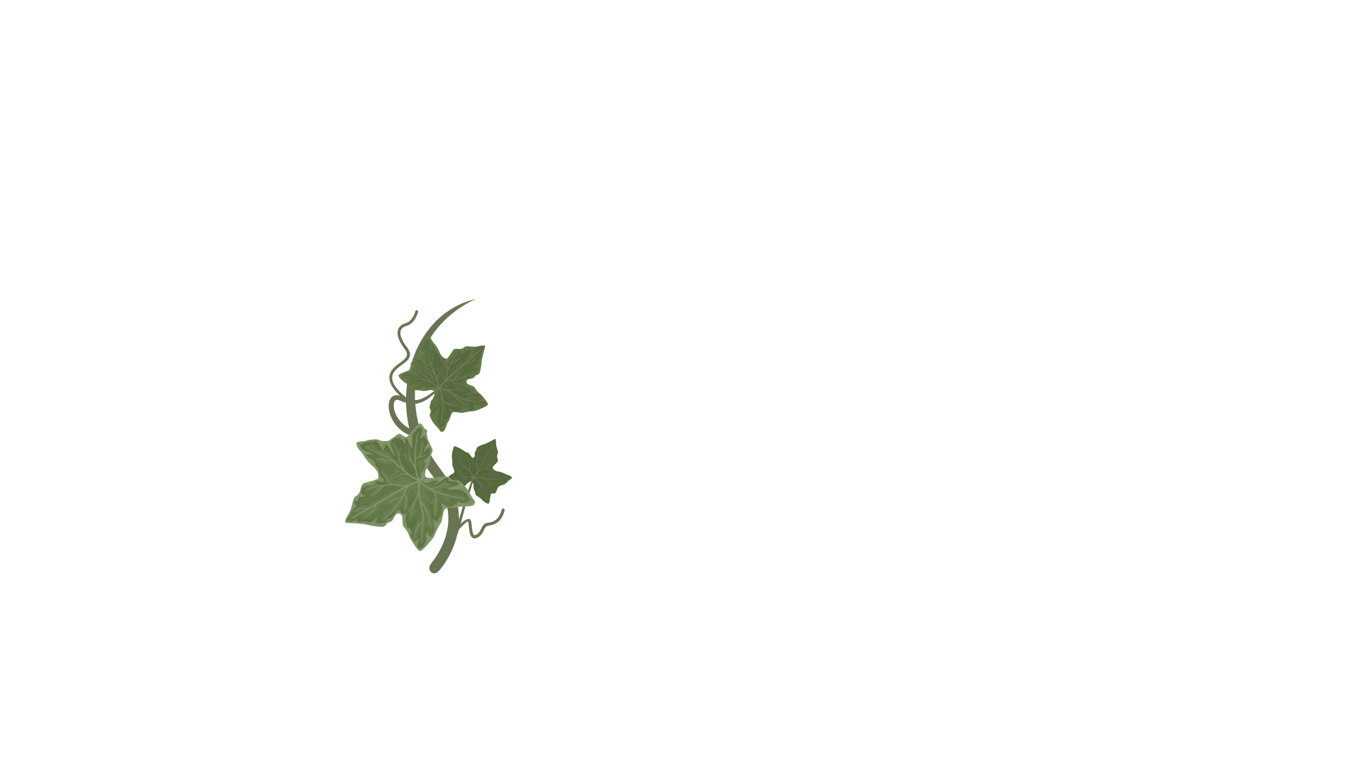
Hypothesis
Hypothesis 1
Mercury is the closest planet to the Sun and the smallest one in the Solar System—it’s only a bit larger than the Moon
Hypothesis 2
Jupiter is a gas giant and the biggest planet in the Solar System. It's the fourth-brightest object in the night sky
Hypothesis 3
Venus has a beautiful name and is the second planet from the Sun. It’s terribly hot—even hotter than Mercury

Slide 9
Study objectives
Mercury
Venus
Mars
It’s the closest planet to the Sun and the smallest one in the Solar System
Venus has a beautiful name and is the second planet from the Sun
Despite being red, Mars is actually a cold place. It’s full of iron oxide dust

Slide 10
Literature review
AUTHOR (YEAR). Title of the publication. Publisher
  Mercury is the closest planet to the Sun and the smallest one in the Solar System
AUTHOR (YEAR). Title of the publication. Publisher
  Mars is full of iron oxide dust, which gives the planet its reddish cast
AUTHOR (YEAR). Title of the publication. Publisher
  Jupiter is a gas giant and the biggest planet in the Solar System
AUTHOR (YEAR). Title of the publication. Publisher
  Venus has a beautiful name and is the second planet from the Sun
AUTHOR (YEAR). Title of the publication. Publisher
  Earth is the third planet from the Sun and harbors life
AUTHOR (YEAR). Title of the publication. Publisher
  The Sun is the star at the center of the Solar System

Slide 11
Theoretical Framework
theoretical Framework
Key terms
Relevant theories
Mercury is small
Earth harbors life
Jupiter is quite big
Theory 1
Saturn is a gas giant and has rings. It’s composed mostly of hydrogen and helium
Our
framework
Venus has a beautiful name and is the second planet from the Sun. It’s hot and has a poisonous atmosphere
Theory 2
Neptune is the fourth-largest planet by diameter in the Solar System

Slide 12
Schedule
Task 1
Jan | Feb | Mar | Apr | May | Jun
Task | Description |  | Date |  | Status
Task 1 | Mars is actually a very cold place |  | Jan 1 - Mar 15 |  | Completed
Task 2 | Earth is where we all live |  | Feb 1 - Apr 30 |  | In progress
Task 3 | Venus has a beautiful name |  | May 15 - Jun 30 |  | Delayed
Neptune is far away from Earth
Task 2
Mercury is the smallest planet
Task 3
Saturn is a gas giant

Slide 13

A picture always reinforces the concept
Images reveal large amounts of data, so remember: use an image instead of long texts

Slide 14
333,000
9h 55m 23s
386,000 km
The Sun’s mass compared to Earth’s
Jupiter’s rotation period
Distances between Earth and the Moon

Slide 15
Methodology
Mercury is the closest planet to the Sun and the smallest one
Type of data
Venus has a beautiful name and is the second planet from the Sun
ROMe
Motives
Despite being red, Mars is actually a cold place. It’s full of iron oxide dust
Data collection
Jupiter is a gas giant and the biggest planet in the Solar System
Specific sampling

Slide 16
Analysis and development
Phase 1
Phase 2
Mercury is the closest planet to the Sun and the smallest one in the Solar System—it’s only a bit larger than the Moon
Jupiter is a gas giant, the biggest planet in the Solar System and the fourth-brightest object in the night sky
Neptune is the farthest planet from the Sun. It's also the fourth-largest planet by diameter in the Solar System
Venus has a beautiful name and is the second planet from the Sun. It’s terribly hot—even hotter than Mercury
Saturn is a gas giant and has several rings. This planet is composed mostly of hydrogen and helium
Earth is the third planet from the Sun and the only one that harbors life in the Solar System. This is where we all live

Slide 17
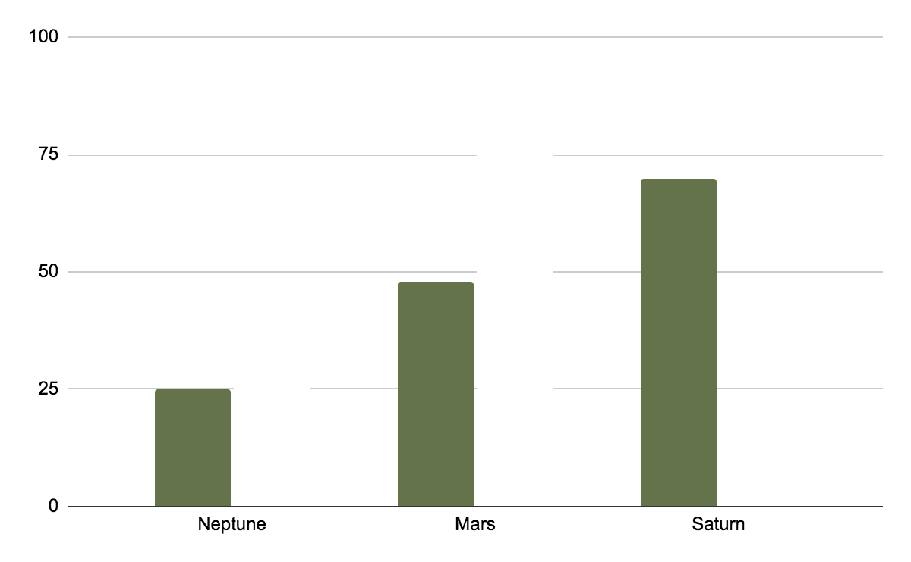
Analysis and development
Mercury is the closest planet to the Sun and the smallest one in the Solar System—it’s only a bit larger than the Moon. The planet’s name has nothing to do with the liquid metal
The Sun is the star at the center of the Solar System
Jupiter is the biggest planet in the entire Solar System
Saturn is composed mostly of hydrogen and helium
NEPTUNE
Venus
Neptune is far away from Earth
Venus is the second planet to the Sun
Follow the link in the graph to modify its data and then paste the new one here. For more info, click here

Slide 18
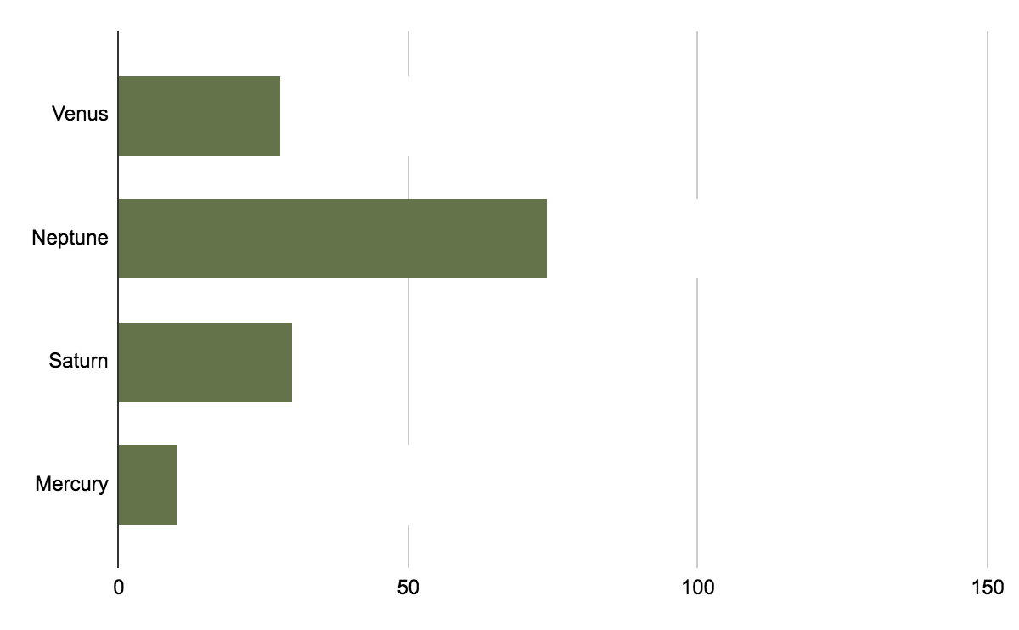
Analysis of the results
Mars
Despite being red, Mars is actually a cold place. It’s full of iron oxide dust
Jupiter
Jupiter is a gas giant and the biggest planet in the Solar System
Follow the link in the graph to modify its data and then paste the new one here. For more info, click here

Slide 19
Roman empire
Latin language
Despite being red, Mars is actually a cold place. It’s full of iron oxide dust
Greek language
Mercury is the closest planet to the Sun and the smallest one

Slide 20
Gods of roman mythology
Diana
Apollo
Juno
Mercury is the closest planet to the Sun
Venus is the second planet from the Sun
Despite being red, Mars is a cold place
Bacchus
Vesta
Venus
Saturn is a gas giant and has several rings
Jupiter is the biggest planet in the Solar System
Neptune is the farthest planet from the Sun

Slide 21
Cultural Legacy
Architecture
Entertainment
Art
Arches
Domes
Colosseum
Gladiators
Theaters
Horse races
Mosaics
Paintings
Sculptures

Slide 22
Discussion
Mars
Greek gods
Despite being red, Mars is actually a cold place. It's full of iron oxide dust, which gives the planet its reddish cast. Earth is the third planet from the Sun and the only one that harbors life in the Solar System. This is where we all live:
Ceres is located in the main asteroid belt
The Moon is Earth’s natural satellite
Neptune is very far away from us
Pluto now considered a dwarf planet
Mercury is the closest planet to the Sun and the smallest one in the Solar System—it’s only a bit larger than the Moon
Roman gods
Venus has a beautiful name and is the second planet from the Sun. It’s terribly hot—even hotter than Mercury

Slide 23
Conclusions
Mars
Venus
Despite being red, Mars is actually a cold place. It’s full of iron oxide dust
Venus has a very beautiful name and is the second planet from the Sun
Mercury
Neptune
Mercury is the closest planet to the Sun and the smallest one in the Solar System
Neptune is the fourth-largest object by diameter in the Solar System

Slide 24
Bibliographical references
Do you know what helps you make your point clear? Lists like this one:
They’re simple
You can organize your ideas clearly
You’ll never forget to buy milk!
And the most important thing: the audience won’t miss the point of your presentation at all. Let’s use lists!

Slide 25
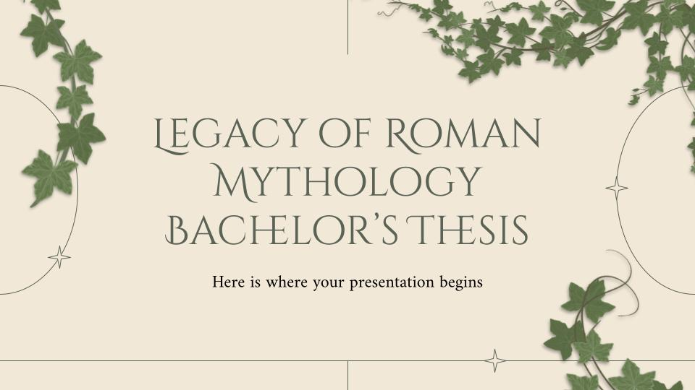

Desktop MOCKUP
You can replace the image on the screen with your own work. Just right-click on it and select “Replace image”

Slide 26
Thanks
Do you have any questions?
addyouremail@freepik.com l +91 620 421 838 yourcompany.com
Please, keep this slide for the attribution

